Slide 1

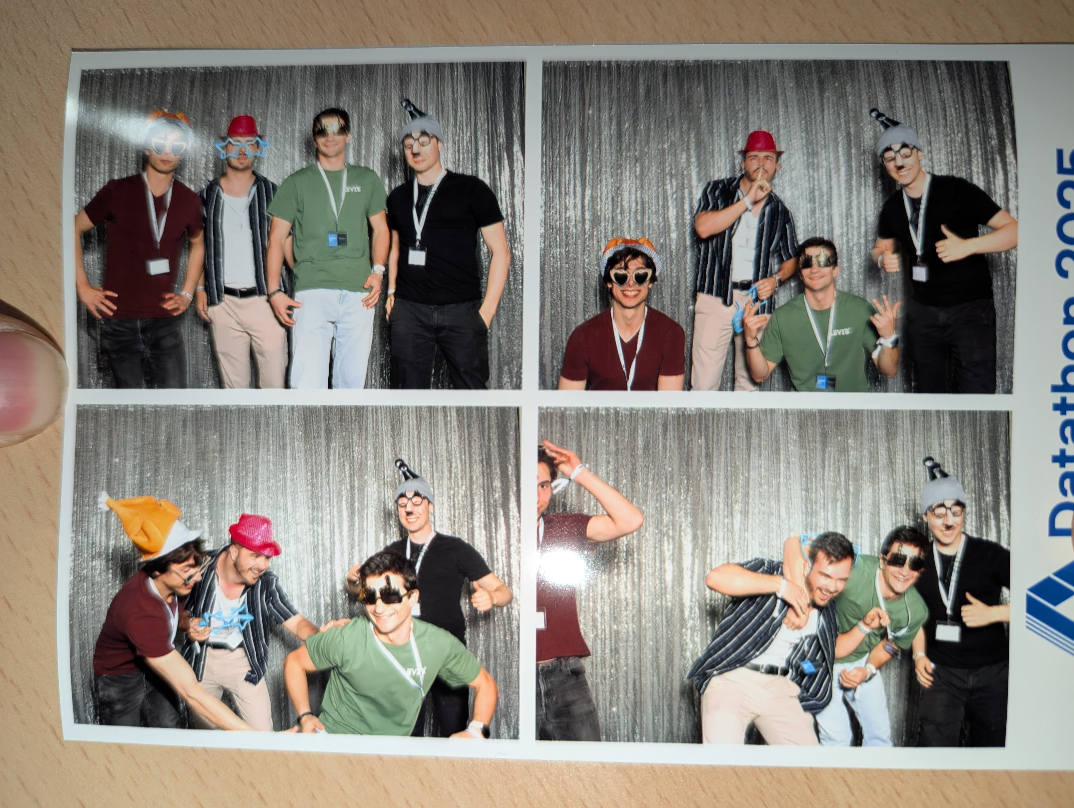
Sentient Challenge by Blubomberbing
Team:
Andrea Ghirlanda
Patrick Zimmermann
Virgilio Strozzi
Max Krähenmann

Slide 2
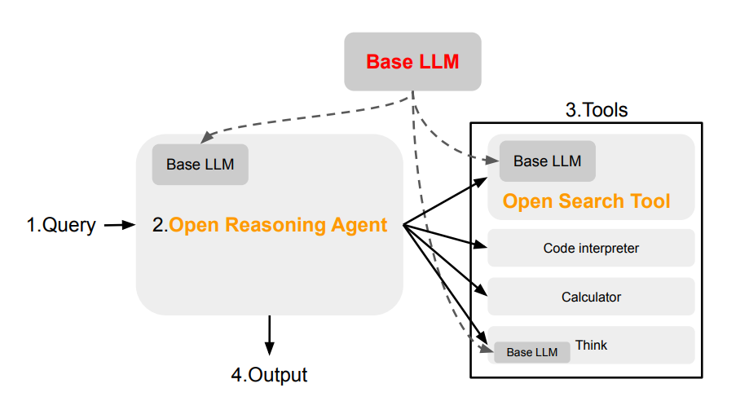
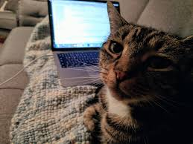
Framework
Llama 70B for all LLM tasks
Added:
SPARQL Wikipedia tool
Code interpreter called fact-checker
New prompts

Slide 3

Further ideas
Integrate more smolagents
Improve the our wikiagent
Create more prompts
Vibe

Slide 4

Results
Generating

Slide 5
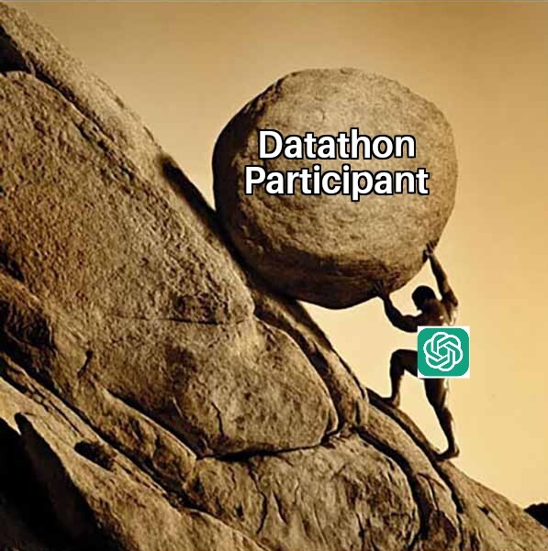
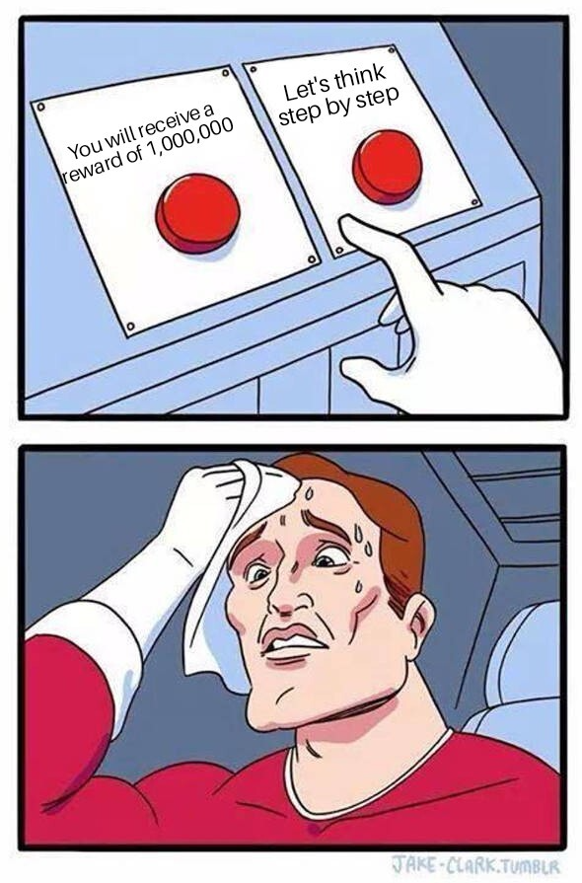
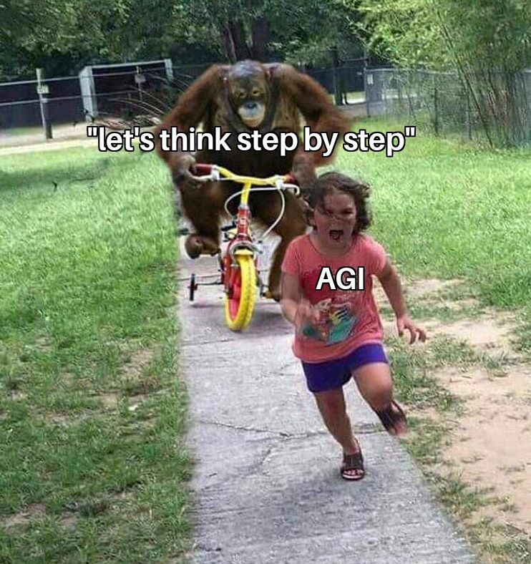
Our Expericen

